Slide 1

Lesson 5 CN4005: Group Work & Diversity
Dr Fadi Safieddine
1
Dr. Fadi Safieddine copyright 2021

Slide 2

Lecture content
Value of team work in a group
Difficulties working in a group
Roles within a group
What makes a good team player
Having a back-up plan
What makes a team work well
Working with diverse people.
Final reflection

Slide 3
Employer requirements for jobs
1.Value of team work in a group
Accounts Trainee: HALIFAX, WEST YORKSHIRE
Eagerness to work as the part of a successful team
Planning Manager: LEEDS, WEST YORKSHIRE,
Good team player with the ability to work closely with colleagues and other departments at all levels
Purchase Ledger Supervisor: Halifax, Yorkshire,
The purchase ledger clerk will be a good team player, as well as a leader of people and lead by example.
`
Sales Consultant, Pontefract, WF8 4PR
Work well as part of a team
Research and Knowledge Transfer Officer, UoB,
Strong team-working skills, strong interpersonal and communication skills.

Slide 4
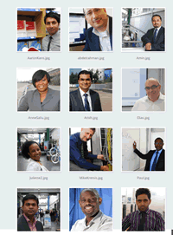
Working in London:
1.Value of team work in a group
Diverse people
Different values
Different approaches
Transient workforce
Continuation and progress
Clear management structure
Strong communication
Clear teamwork ethos

Slide 5

Working with other students:
1.Value of team work in a group
Assignments
Presentations
Lab work
Projects
Work placements

Slide 6
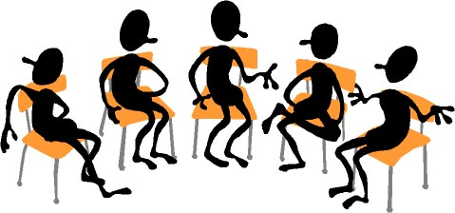
2.Difficulties working in a group
What difficulties have you had
working with other people in a group?

Slide 7
Characters
2.Difficulties working in a group
Characters | Advantage | Disadvantage
Dominant and loud | Motivated and would drive the team forward | Could be considered bullying and may end up doing all the work.
Inclusive (‘we’ and ‘all’) | Brings people together and allows excellent negotiator. | May end up being too concerned about the ‘group’ than the ‘project’.
Polite and makes suggestions | Ideal team play who is happy to follow on their activities. | Could be overwhelmed or overshadowed.
Offensive and abrupt | Rebellious ideas can be source of creative ideas. | May offend group members and get sided.
Shy or bored character. | Listeners and participators | May need prompting and may feel outside the group

Slide 8
End of Part 1
Activity 5.1. You have all worked in groups in the past, working with friends at school on an assignment or project. Indicate the most common reason why the team did not perform to its full capacity.
Conflicts between team members
Lazy team leader: Team leader expects others to do the work for them.
Team leader too nice to everyone, even those not doing the work.
Poor communication: Not discussing changes or progress with the team.
Authoritarian team leader: “My way or the highway!”

Slide 9
Results of last term survey:
2.Difficulties working in a group
Part 2

Slide 10
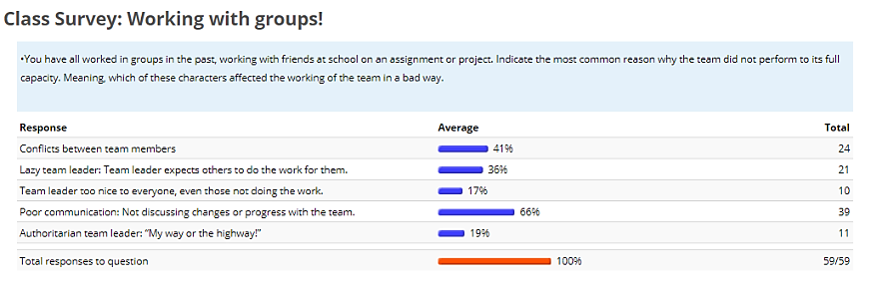
Results of last term survey:
2.Difficulties working in a group

Slide 11
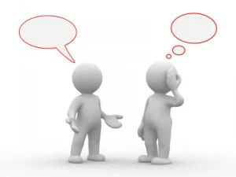
Two main issues:
2.Difficulties working in a group
Communication
To members of the group
Written work
Presentations
Commitment
Attending meeting
Participation in meetings
Fulfilling promised work

Slide 12
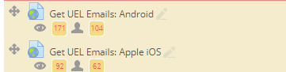
Exchanging Contacts
2.Difficulties working in a group
UEL Email (first means of contact).
Set up to get UEL emails on your phone
Found under week 1

Slide 13
Exchanging Contacts
2.Difficulties working in a group
Personal Email
WhatsApp (optional)
Very important in your first meeting to agree on a time when everyone is able to meet once a week.
Ideally, pick time before or after the class
Or on the same day.

Slide 14
Setting up meetings
2.Difficulties working in a group
Use MS Teams to set up meetings.
It is very simple:
Go to you Calendar, click on a time in the future when everyone is free to meet.
Select the students IDs
Send – next is demo on how to arrange a meeting with your group.

Slide 15
Creating a meeting on MS Teams

Slide 16

Create your contract
2.Difficulties working in a group
Next is my suggestion:
You could agree with my suggestions
You could start your own protocols of communication and reporting.
You must agree on key things:
The outcome you want.
Team structure.
How the work will be distributed.
What procedures you will take to ‘removing’ a group member for failing to participate or contribute.
This has to be typed in an email and sent to everyone!

Slide 17
End of Part 2
Activity 5.2. How long would you wait before raising the alarm that a group member is not participating? (Select as many)
Two days
After they miss three meetings without contact.
When they fail to respond to three contacts and you have waited a week.
You meet as a group and agree to suspect the member for failing to participate.
Also, you can make your own agreement but it has to be in writing.

Slide 18
Your responsibilities as a member
2.Difficulties working in a group

Slide 19
Your responsibilities as a member
2.Difficulties working in a group
If they are unable to attend:
Let the group members know if they are unable to attend.
Send them any work (even if incomplete) to show you are still engaging.
Expect an email from a member with details of what ‘they have to do’.

Slide 20

Roles: rotate?
3.Roles within a group
Chair or facilitator:
ensures everyone gets an opportunity to contribute in meetings and to task
ensures all important points covered
Note-taker: Write what you agreed on.
Time-keeper:
keeps meetings moving
Group co-ordinator:
contact details
books room
produces and distributes meeting notes and agenda

Slide 21
Allocating roles
3.Roles within a group
Get to know your group to work out individual skills and qualities

Slide 22
A. Social skills and qualities
4.What makes a good team player
Active listening
Social perceptiveness
Self-monitoring
Selflessness
Warmth and co-operation
Patience and tolerance

Slide 23
B. Inter-personal and self-management knowledge, skills and abilities
4.What makes a good team player
Conflict resolution
Collaborative problem solving
Communication
Goal-setting and performance management
Planning and task co-ordination

Slide 24
Backup plan?
5.Having a back-up plan
Imagine you are in a project and someone falls ill.
They might not be able to complete their bit of the project!
What will you do?

Slide 25
Continuation:
5.Having a back-up plan
Keep each other updated at meetings
Ensure any relevant information is shared amongst the group
Allocate a substitute to, e.g., deliver the
presentation/ write up the final report/ perform
the lab practical.

Slide 26
6.What makes a team work well
Organisation
Having a clear agreement (plan)
Being positive and open to the group experience
Being prepared
Having a Plan B

Slide 27
Summary of the points:
1.Value of team work in a group
2.Difficulties working in a group
3.Roles within a group
4.What makes a good team player
5.Having a back-up plan
6.What makes a team work well

Slide 28
References
Levin, P. (2005) Successful teamwork. Maidenhead: Open University Press.
West, M. (2004) Effective Teamwork. 2nd ed. Oxford: Blackwell Publishing.

Slide 29
End of part 3
Activity 5.3. What makes a great team? (Tick as many relevant items):
To be organised and prepared
Have a backup plan if there are problems.
Having a clear team structure.
Having an agreement from the start with objectives, protocols, including actions in case of slacking.
Being positive and constructive in your work.

Slide 30
Diversity and inclusivity

Slide 31
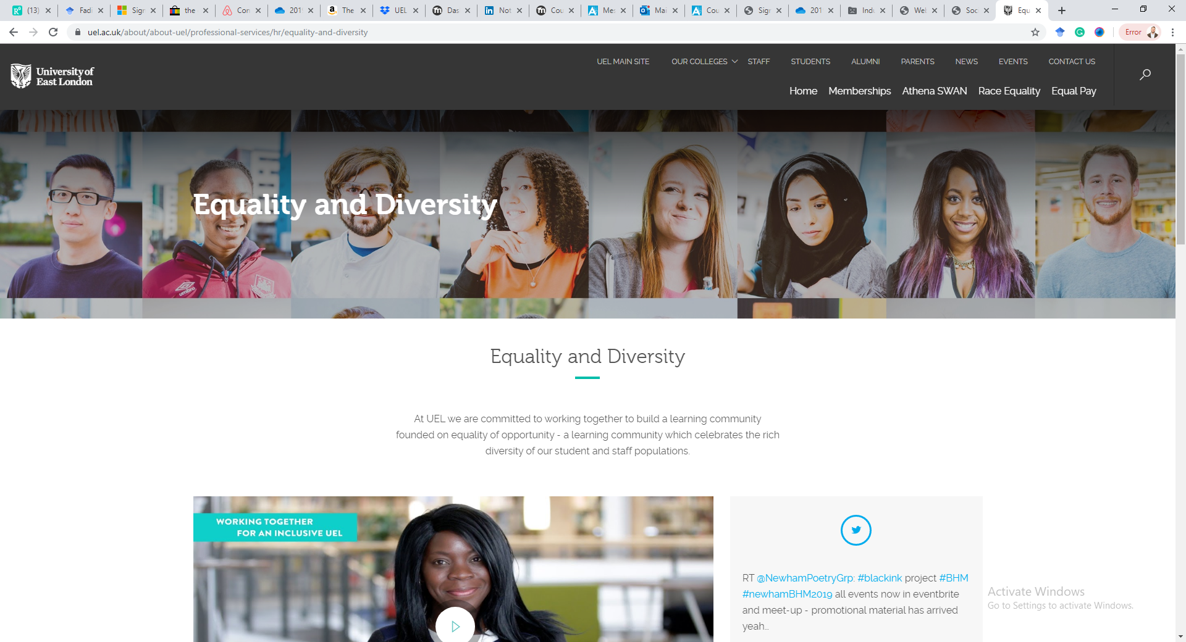
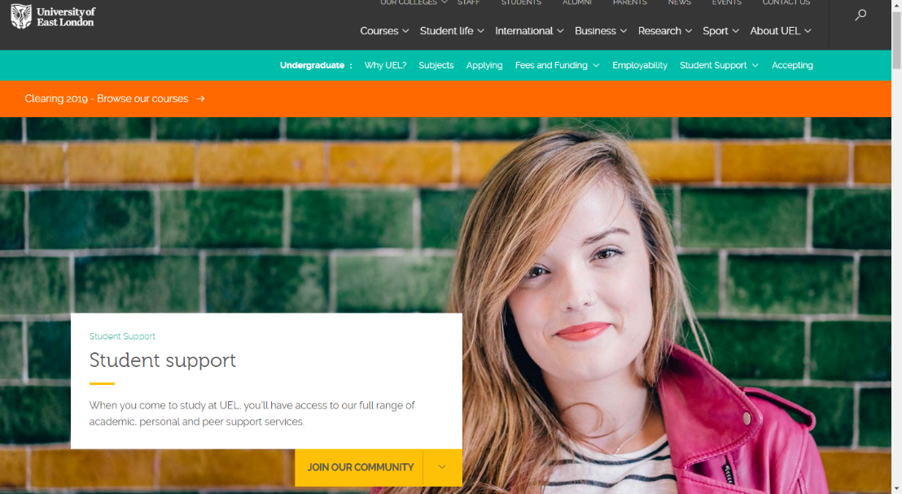
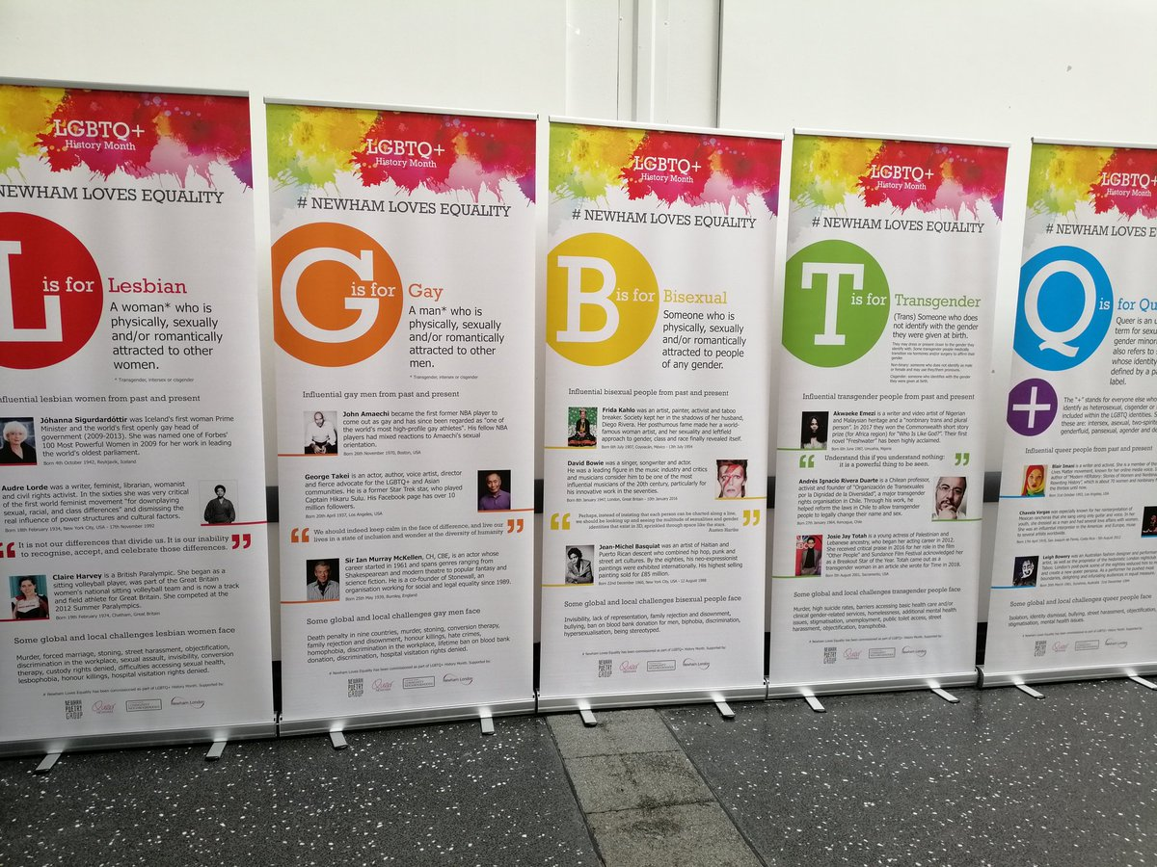
Diversity and inclusivity

Slide 32
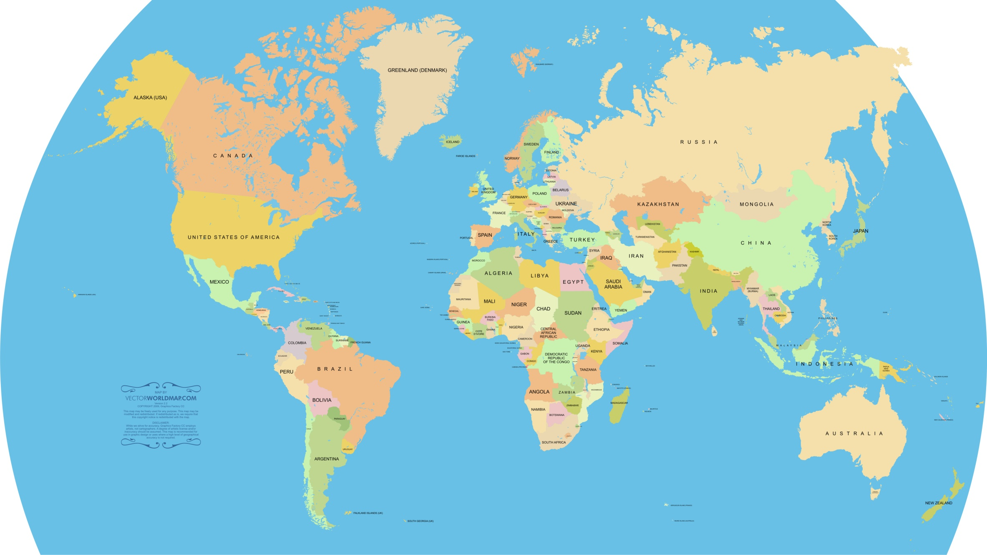
What is this?

Slide 33
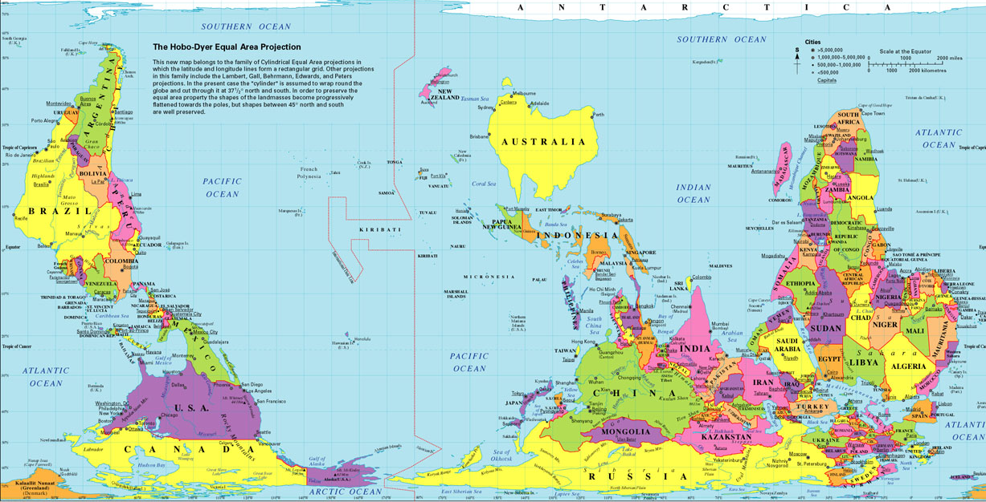
What is this?

Slide 34
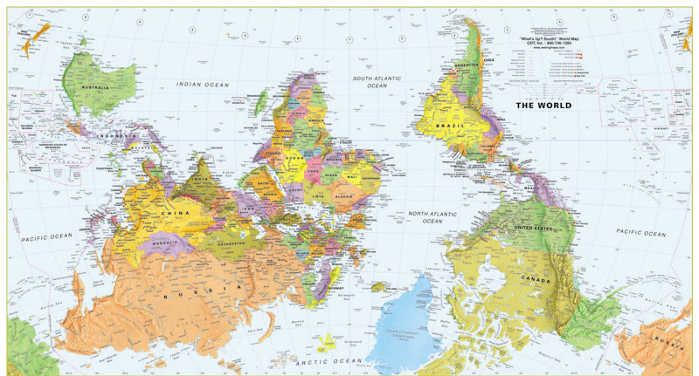
What is this?

Slide 35
Perspective?
What it means to be egocentric?
What it means to be able to put yourself in the other person’s shoes?
Different people may have different perspectives, it does not mean they are wrong.

Slide 36
What do they mean?
Diversity is about recognising and celebrating differences.
Inclusivity is understanding and catering for the different potentials, needs and resources of people– levelling the field.

Slide 37
Protected Characteristics (9PC’s)*
Age | Gender | Race
Disability | Sexual Orientation | Religion or Belief (or a lack of belief)
Gender Reassignment | Pregnancy and Maternity | Marriage / Civil Partnership
* Equality Act 2010

Slide 38
Protected Characteristics (9PC’s)*
Age | Gender | Race
Disability | Sexual Orientation | Religion or Belief (or a lack of belief)
Gender Reassignment | Pregnancy and Maternity | Marriage / Civil Partnership
* These are called ‘invisible EDIs’

Slide 39

How a diverse team work?
3 Minute video:
https://products.office.com/en-gb/yammer/yammer-overview

Slide 40
Keep an eye on the diversity of the workforce and teams.

Slide 41
End of part 4
Activity 5.4. Reflect on the video you just saw on “promoting Yammer”, which of the characteristics of individuals did you see:
Age (Employees of all ages)
Gender (Females in different managerial roles)
Race (Diverse and covering different managerial roles)
Disability
Sexual Orientation (LGBTQ+ Rainbow)
Faith
Pregnancy (parenting)

Slide 42
Additional information

Slide 43
UEL Equality and Diversity unit:
Google UEL Equality and Diversity (first link).
Equality and Diversity Team
EB.2.17
Docklands Campus
T. 020 8223 7069
E. equality@uel.ac.uk

Slide 44
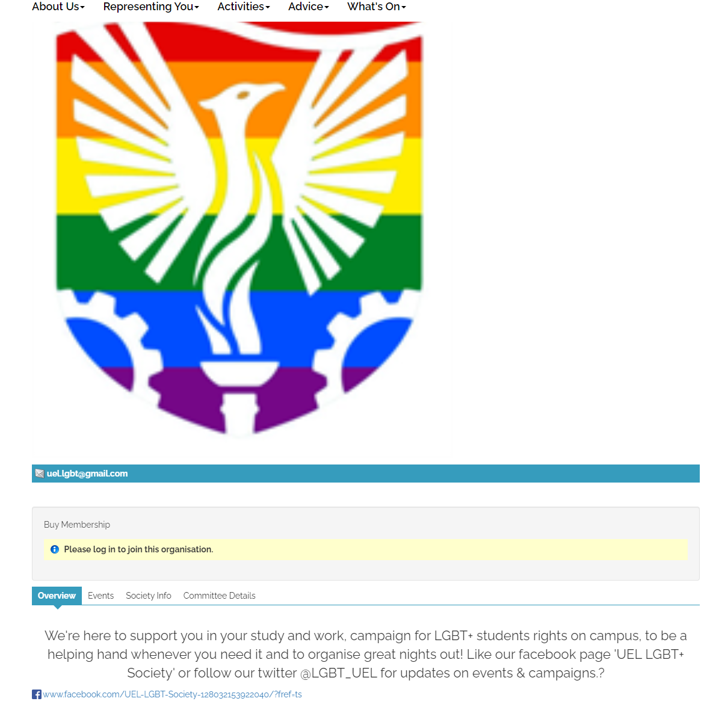
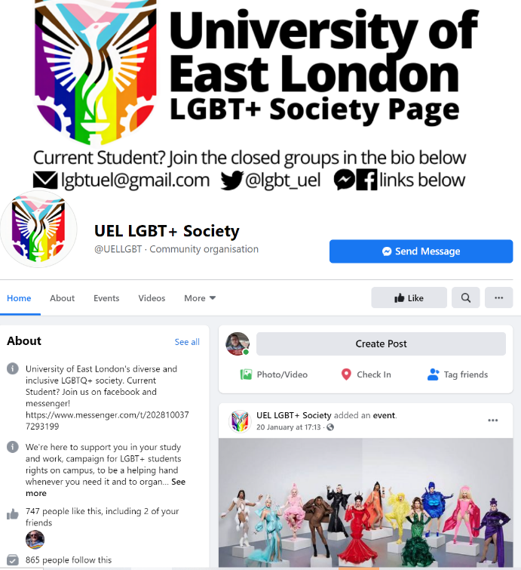
LGBT+ Student Society
https://www.uelunion.org/society/lgbtqia/
https://www.facebook.com/UELLGBT/

Slide 45
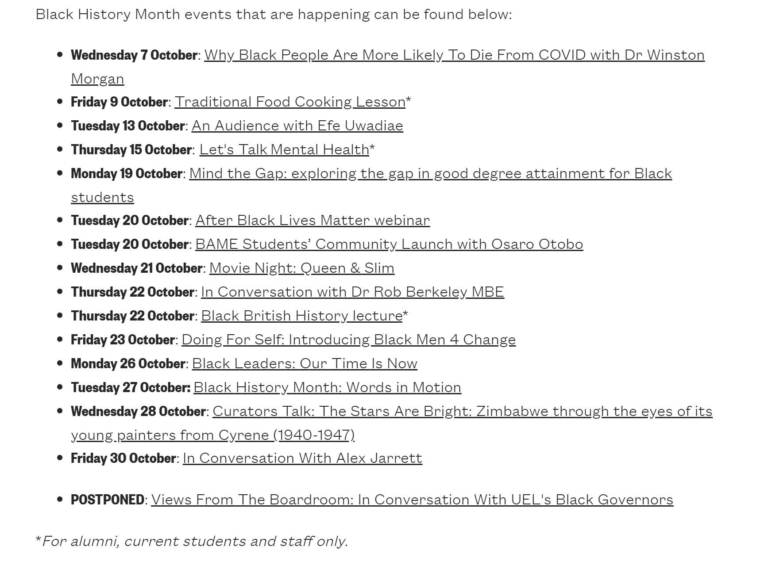

Black History Month
October 1st to 31st.
https://www.uel.ac.uk/events/2020/10/black-history-month-at-uel

Slide 46
Health and Wellbeing
Google UEL Health and Wellbeing. https://www.uel.ac.uk/undergraduate/student-support

Slide 47
Join groups in the Student Union

Slide 48
Join groups in the Student Union

Slide 49
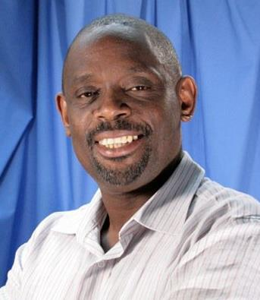
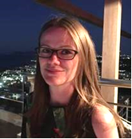
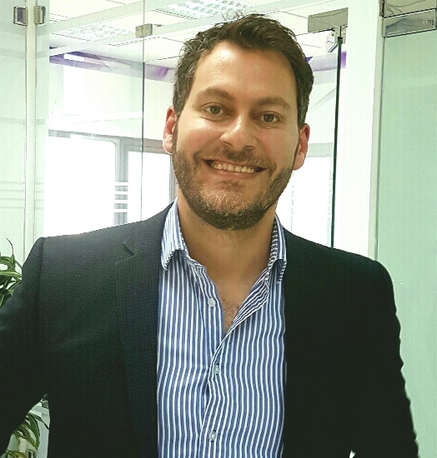
E&D and Athena SWAN
E&D Chair – Solomon Alexis
A.S.Alexis@uel.ac.uk
AS Chair - Louise Todd:
L.Todd@uel.ac.uk
AS Co-Chair: Fadi Safieddine
Fadi@uel.ac.uk

